Slide 1
Virtual Teams: Preparing Students for Global IT Management
Bruce White, Bill Tastle, Andrei Semeniuta

Slide 2
Overview
We are living in a global economy. Outsourcing, multi-national companies, and instant communications worldwide are becoming the norm.
But … are our students ready for this?
Three professors established an experimental ‘Virtual Global Team’ with two students from each campus to explore the topics

Slide 3
So … what is a ‘Virtual Team’?
The Online Business Dictionary defines “Virtual teams” as: “Whose members are interact primarily through electronic communications.
“In today’s market, global virtual teams are not the exception, but the rule as companies expand into the global market”.
“Face-to-face teams are no longer the norm in global business”.

Slide 4
Why ‘Global Virtual Teams’?
Travel costs are up
May be easier to quickly create a team of talented people
The tools are available for virtual teams
Expertise is not just in the American domain
Following the concepts in ‘The World is Flat’ by Thomas Friedman

Slide 5
How to have success with Virtual Teams
Three success factors:
Team formation
Trust and collaboration
Team communication.

Slide 6
Team Formation
Clear Sponsorship
Solid goals / direction
‘Right’ knowledge and skills
Aligned with company’s strategic goals
Successful ‘kick-off’ meeting
Team identity
And … a clear understanding of cultural differences

Slide 7
Trust and Collaboration
“Trust is at the foundation of all successful relationships”
A need to explicitly establish and foster relationships
‘Face-to-face’ communication helps
Create a team identity
Celebrate team collaboration

Slide 8
Team Communication
Technologies continue to improve here:
‘Face-to-face’ meetings
Collaborative sites
Social networking
Weekly teleconferences
Instant messaging, e-mail, corporate wikis and more

Slide 9
Offshoring / Outsourcing Issues:
The economic and business logic for IT offshoring
The dangers in offshoring IT activities
Management of offshoring
Offshoring and IT job opportunities in organizations
Changes to the IS/IT curriculum to prepare future IS/IT managers to manage offshoring

Slide 10
‘Soft skills’ need to be strengthened – with the development of trust and partnerships
“How do we prepare our students for the world of virtual teams”?

Slide 11
Our Project
Three professors collaborated to create a ‘global virtual team’
The professors were:
William (Bill) Tastle – Ithaca College, New York
Bruce White – Quinnipiac University, Connecticut
Andrei Semeniuta – Belarusian Trade-Economic University, Gomel, Belarus
Each selected two students

Slide 12
(an observation)
A person who speaks three or more languages is ‘multilingual’
A person who speaks two languages is ‘bilingual’
A person who speaks one language is an American

Slide 13
Ground Rules for the GVT
Students needed to explore the communications technologies available
Students needed to collaborate on three projects
Students needed to ‘publish’ their collaborative findings

Slide 14
Students
From Ithaca College:
Stephanie Elowson, Feifel Huang
From Quinnipiac University:
Mike Riddles, Andrew Pauxtis
From Belarus
Serj Kuznetsoff , Kirill Bruzgin

Slide 15
Tools / techniques
Skype for verbal / voice communication (and two-way visual communication)
Google Docs for virtual files
Wikispaces for jointly developed files / documents

Slide 16
Other Issues
International issues:
Cultural issues
Language issues (we used English exclusively)
Time differences (Belarus is 7 hours ahead of eastern US time)

Slide 17
Expectations
Documentation of effort
Desired results
Working through difficulties
Defining success

Slide 18
Project 1 – build the team
Using Gmail, the students communicated about themselves, their interests, and their backgrounds
All interacted with the others with ‘welcomes’ and ‘hellos’

Slide 19
Project 2 – exploring tools
Students divided into three teams:
Team 1 explored Google Docs
Team 2 explored Wikispaces and Zoho for collaborative documents
Team 3 explored Skype for communications and face-to-face communications
Their documents were stored in a team folder on Google Docs and shared with each other and the professors

Slide 20
Discussion
This project was a good first effort into exposing students to global virtual teams.
There was no true face-to-face communication (other than the two students from each campus), although there were verbal interactions (using Skype) among the team.
The students from the three campuses had not met each other previously.

Slide 21
Discussion - continued
Communication and document sharing was done using free Internet based technologies.
The professors were pleased with this initial effort.
Students also expressed pleasure at working on a global basis as a method of gaining understanding in both global issues as well as technological issues.

Slide 22
Direction
The limitation to this study with only three campuses and only six students.
The authors suggest that this can and will be expanded in the future. We encourage others to join with us in the next iteration.
The authors would like to expand the concept to at least five campuses (on at least three continents) with many more students

Slide 23
Questions, Comments, Suggestions?

Slide 24
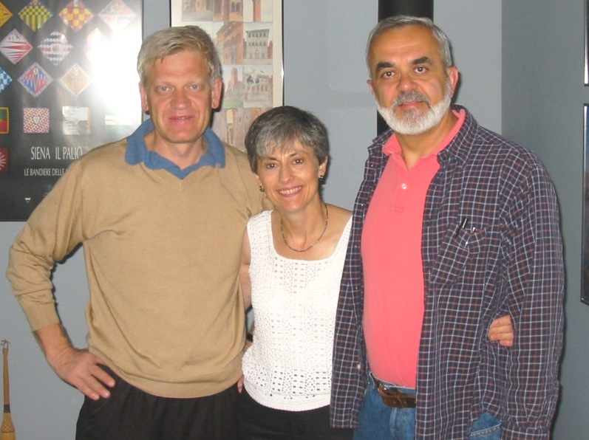
Thank you!!!

