Slide 1
EDSIG Educator of the Year - 2008

Slide 2
Thank You
I have been an educator for over 35 years.
Someplace along that line, I learned that education was more than teaching

Slide 3
My background
I was born and raised in Eastern Iowa (Cedar Rapids)
Did my undergraduate and masters at Winona State University in Winona Minnesota
Taught high school math two years at West Grant Schools (rural Wisconsin) – and coaching basketball and baseball
Taught high school math for five years at Keokuk (Iowa) High School
Taught at Winona State for a two-years
Then to Portland Oregon for 2 years (Mount Hood Community College)
At Dakota State University (Madison SD) for 18 years
And … now in my ninth year at Quinnipiac University

Slide 4
EDSIG / ISECON
I completed my Ph.D. in 1990 from the University of Nebraska
I knew I needed to keep learning and growing, and heard about ISECON
My first ISECON was in Chicago in 1990
I didn’t know anybody
So, when a ‘call for nominations’ to serve on the board came out, I nominated myself … and was elected!!!
I was ISECON Chair in 1995 in St. Louis
I was ISECON Chair in 1996 in Orlando
I was ISECON Chair in 2003 in San Diego
I was ISECON Chair in 2004 in Newport

Slide 5
More on EDSIG /ISECON
I have been on the EDSIG board several times
Served briefly as President
As an information systems educator, I knew that I needed to be informed, and to keep up with my field and to improve
For me, that meant EDSIG and ISECON!!!

Slide 6
Thoughts
In the early 2000’s, I saw three converging forces:
Assessment
Accreditation
Curriculum
I know I needed to be involved
I have worked as an ABET IS Accreditation team visitor since 2004
I have worked on the Center for Computing Education Resource (CCER) assessment project since 2003
I have worked with many giants in Information Systems Education – many of whom have been previously recognized as EDSIG Educators of the Year

Slide 7
Challenges
There are always challenges
We have talked about outsourcing
And we have talked about declining enrollments

Slide 8
Challenges
“Despite the downturn in the technology sector in the early part of the decade, the outlook for computer and information systems managers remains strong. To remain competitive, firms will continue to install sophisticated computer networks and set up more complex intranets and websites.”
(taken from: http://www.bls.gov/oco/ocos258.htm )

Slide 9
Opportunities
We get calls, e-mails, contacts from employers.
The Demand is extremely strong
The Supply is weak
WE NEED MORE IS MAJORS

Slide 10
And … a great opportunity
And … the ‘sun shining behind the storm clouds’ . . .
IS / IT tends to be recession proof.
Our graduates WILL get jobs when other majors will not.

Slide 11
Education Thoughts
We need to think about creating ‘significant learning experiences’
What are we teaching?
Why are we teaching that?
How do we teach?
What are the ‘Higher Order Thinking Skills’ (HOTS)?
How can we challenge our students to think at higher levels of Bloom’s taxonomy?

Slide 12
More education thoughts
How can we assess such learning?
How can we excite students about IS / IT?
How can we excite students with significant learning experiences?

Slide 13
More personal thoughts
I started out as a mathematician
I changed into a computer scientist
I loved programming – the thrill of seeing code work
I was an analytical person
But … as I have aged – and seen computing change – I have changed.
I am now more of a ‘cheerleader’, ‘integrator’, ‘spontaneous’, ‘catalyst’.

Slide 14
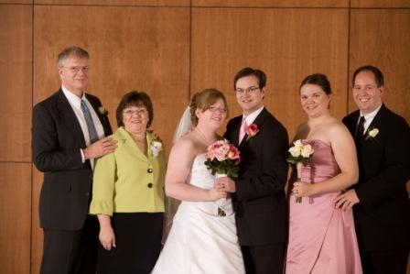
Final personal thoughts

Slide 15
Thanks to:
Connie – my wife for 34 years. (and … has had to put up with me)
My family
Many great friends and mentors (to mention would take a long time … and I might forget somebody)
And … thanks for God for ‘giving me the desires of my heart’!!!

Slide 17
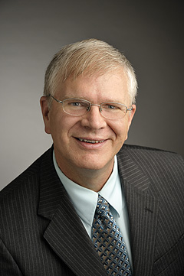
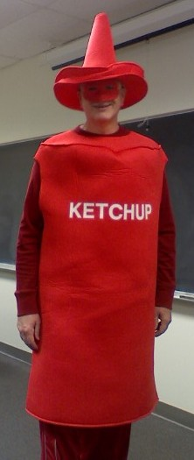
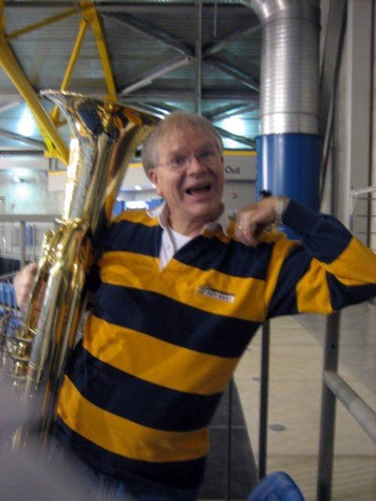
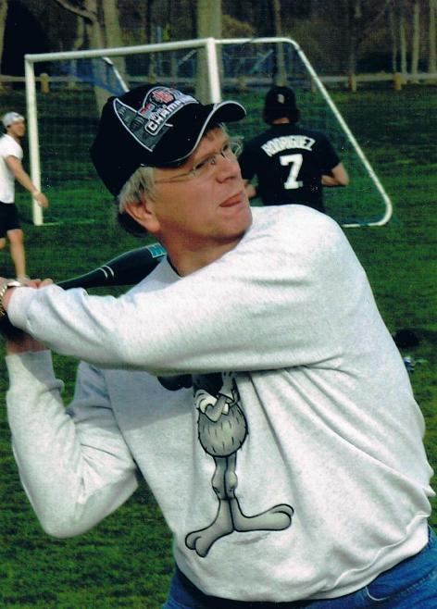
Thank you all

